Slide 1
Olympus Product Backlog showing Sprint 1
Paste a copy of your Product Backlog, showing a minimum of Sprint 1. Pls highlight Sprint 1 in a red box.
This can be a modified version of the Product Backlog that you previously submitted. Pls ensure that Story Points add up to the approx. velocity and that the items delivered are tangible.
I suggest including only 3 items in the Product Backlog (as in my example) to ensure the Sprint Task Board is manageable.

Slide 2
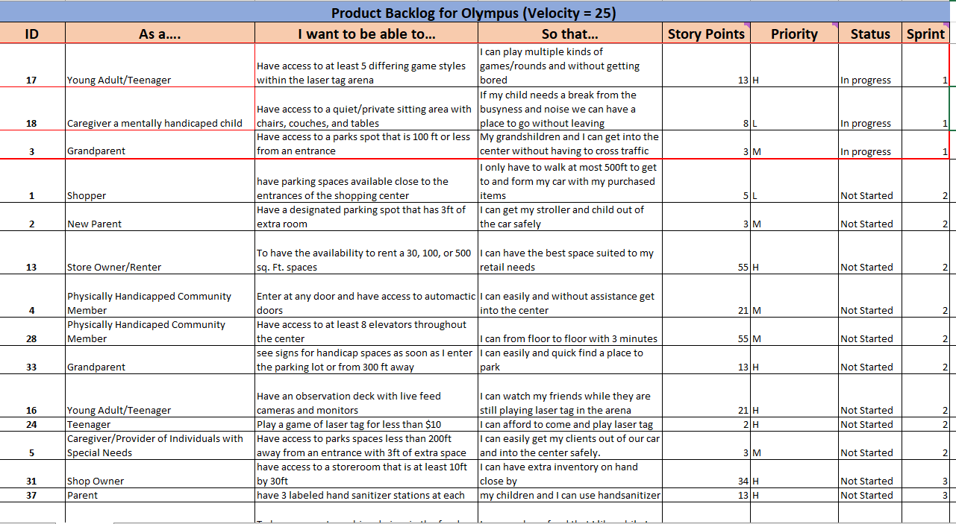

Slide 3
Sprint Task Board (day 10)
Stories
Not Started
In Progress
Complete
PBI #1(13pt)
5 Different Types of Laser Tag Games
Task 4 (3pt)
Modify Modes from User Feedback
Task 2 (5pt)
Create 5 Unique Games Modes
Task 1 (2pt)
Hire Game Director
Task 3 (3pt)
Test 5 Game Modes
PBI #2 (8pt)
Quiet private sitting area for mentally handicapped
Task 4 (1pt)
Place Furniture
Task 3 (1pt)
Purchase Furniture
Task 1(3pt)
Hire Designer who specializes in handicap interior design
Task 2 (3pt)
Design Room Layout/ Choose Furniture
PBI #3 (3pt)
Handicap accessible parking spots <500ft from entrance
Task 3 (1pt)
Paint Lines and Place Signs
Task 1 (1pt)
Measure 500ft from all entrances (allocate spaces)
Task 2 (1pt)
Order Handicap signs and parking lot paint
Total pts = 24
Total pts = 7
Total pts = 7
Total pts = 10

Slide 4
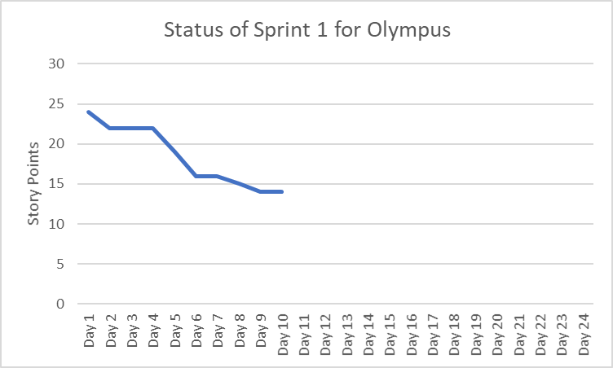
On day 10, there are 14 outstanding story points, 10 have been completed.

